Slide 1



fullstackdatascience.com
Lesson 8 - Get data
and Prepare Data
Power BI
Created by Huydata
DA K6
Lesson 3
huynt@fullstackdatascience.com
1

Slide 2

Learn
About
01/
Get data
02/
Prepare data
03/
Lab
fullstackdatascience.com
2

Slide 3
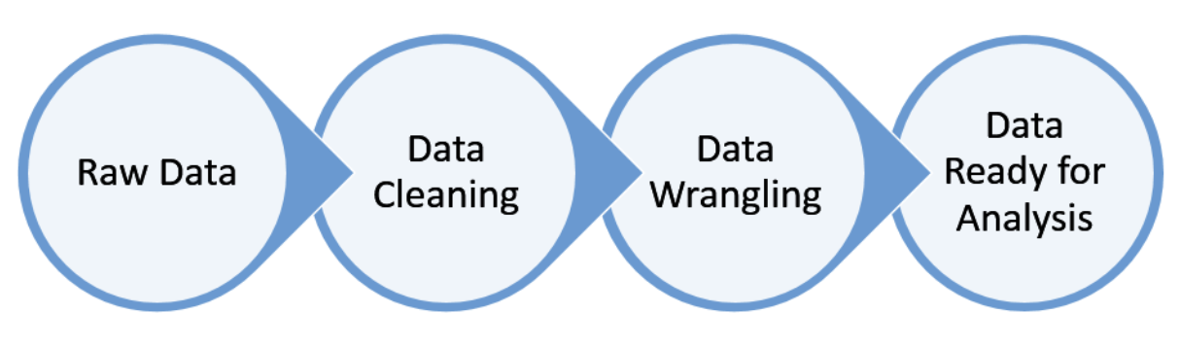
Get data
Get data and Prepare data are the first two steps and also the two steps that determine the accuracy of the analysis.
3

Slide 4
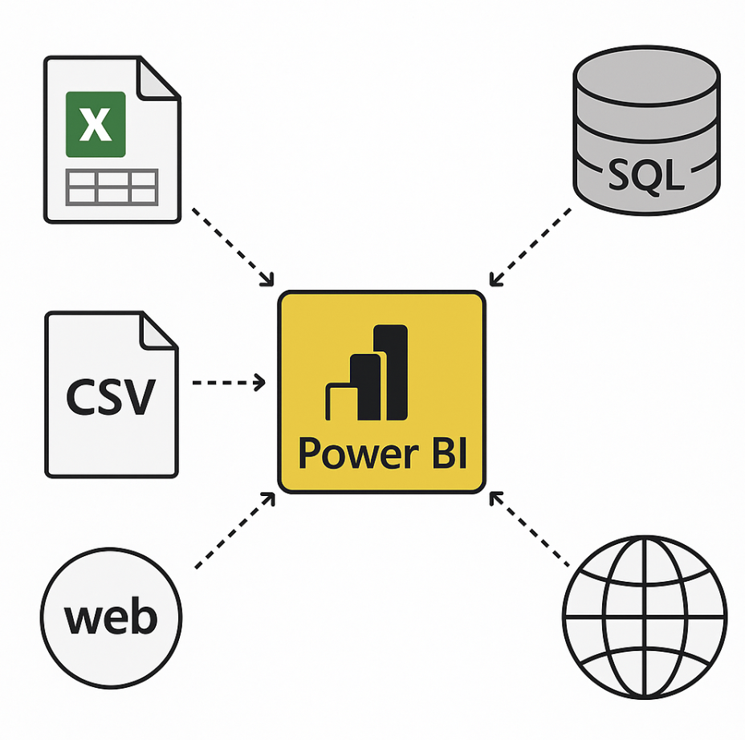
Get Data Process
5

Slide 5
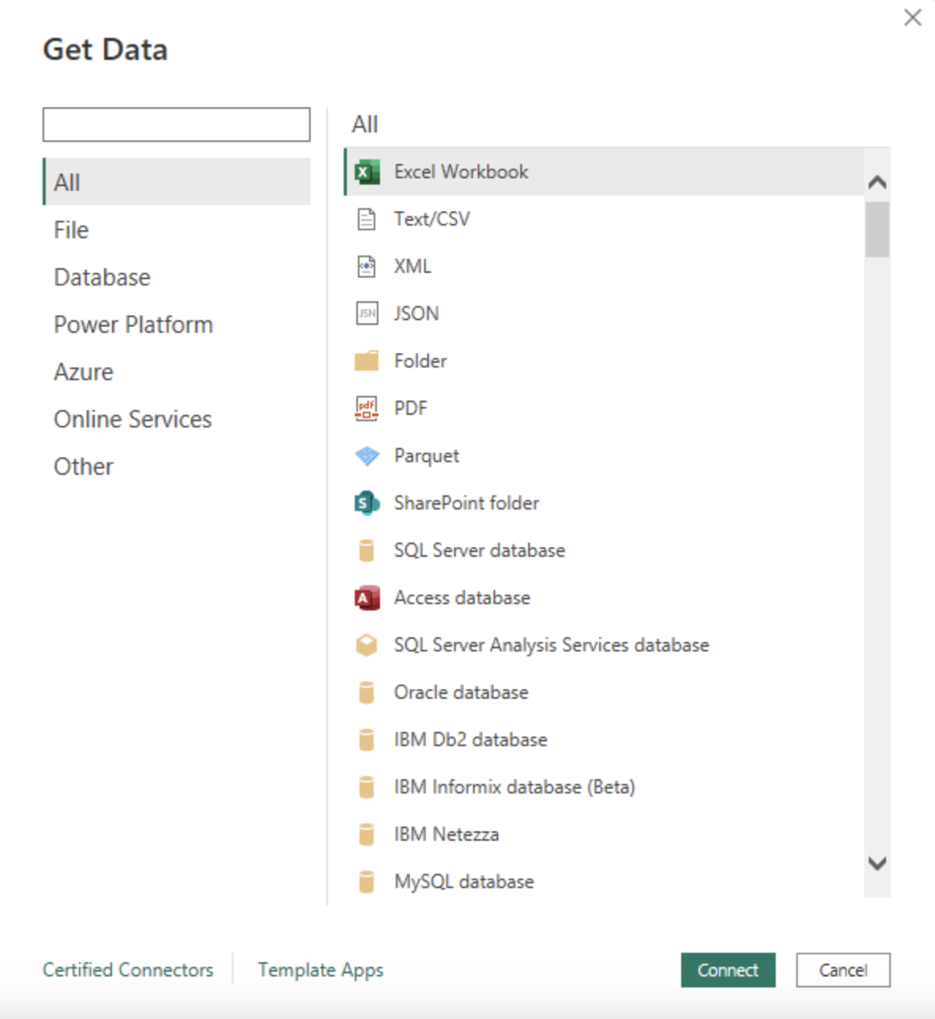
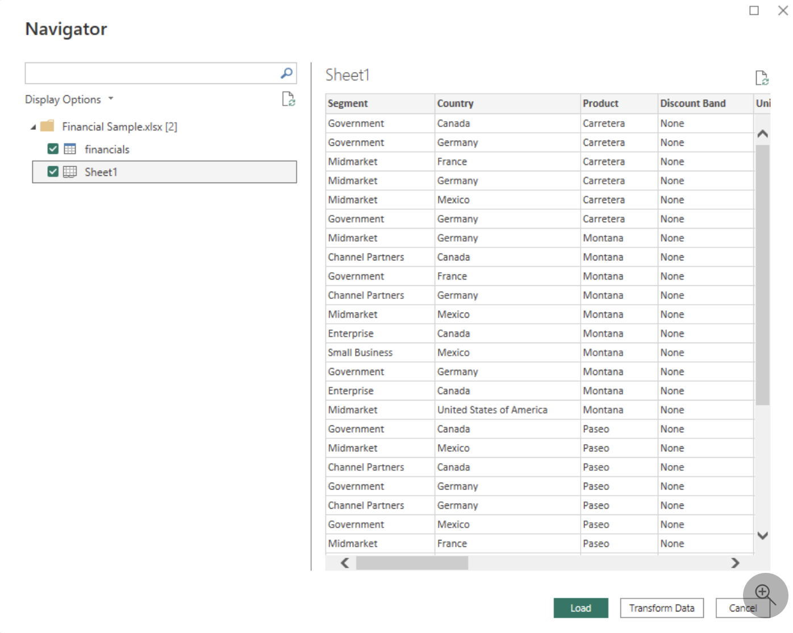
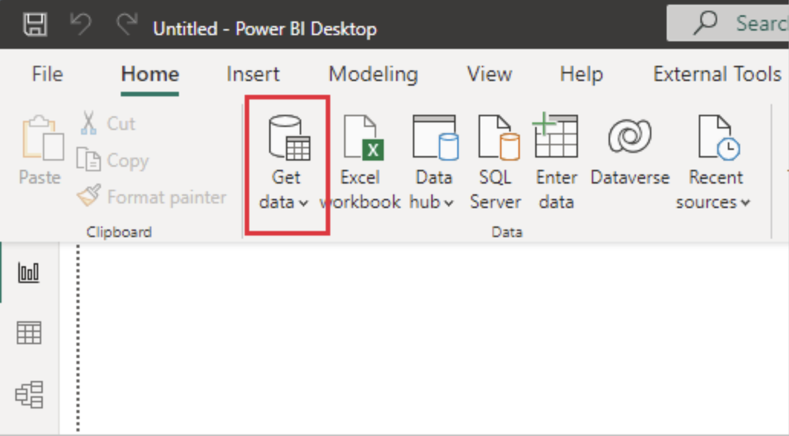
Connect to data (Excel/CSV)
5

Slide 6
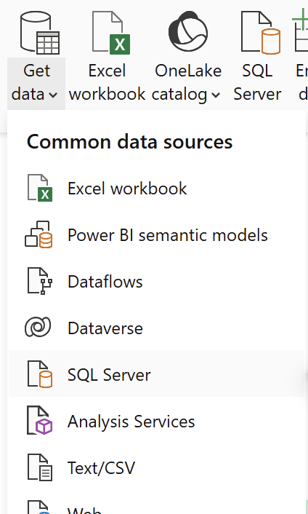
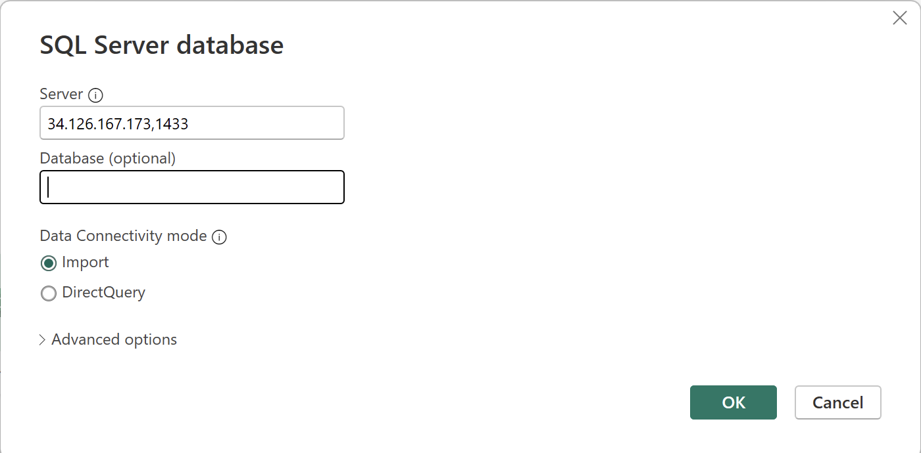
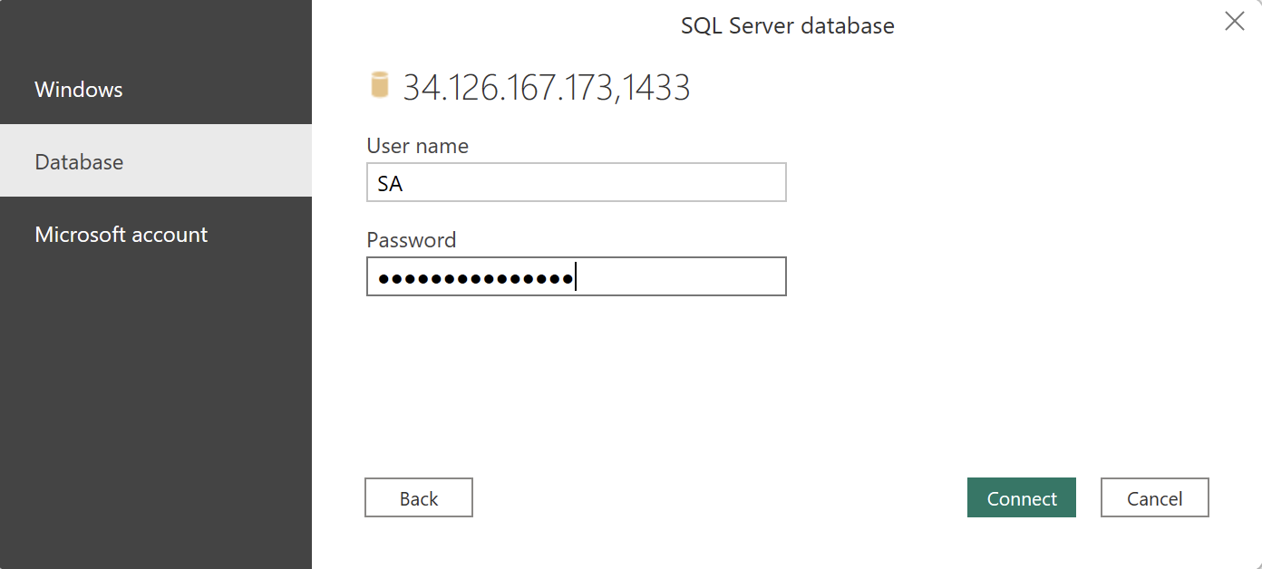
Connect to data (SQL Server)
5

Slide 7
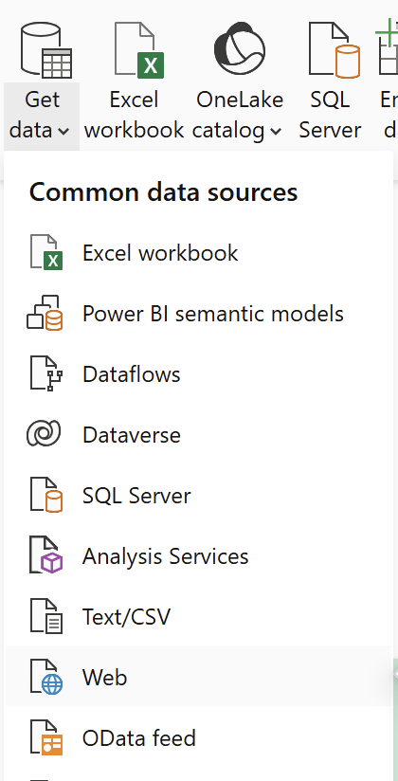
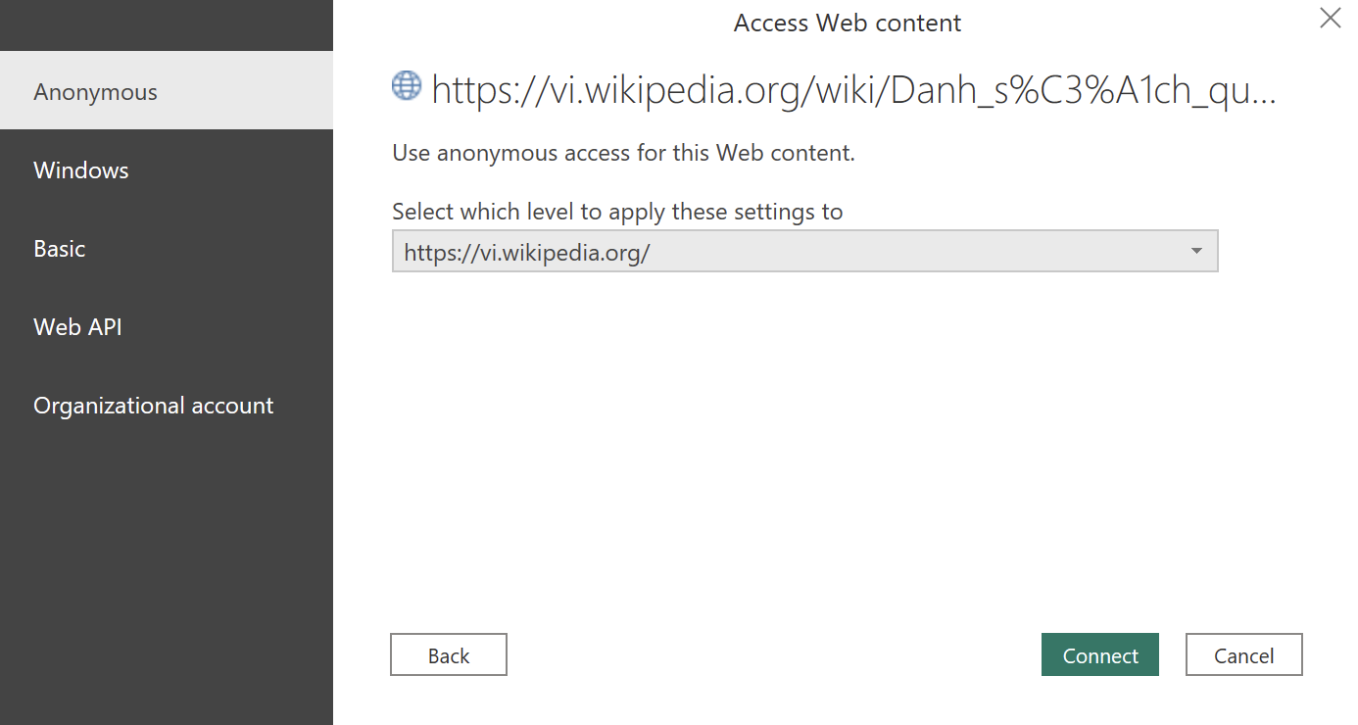
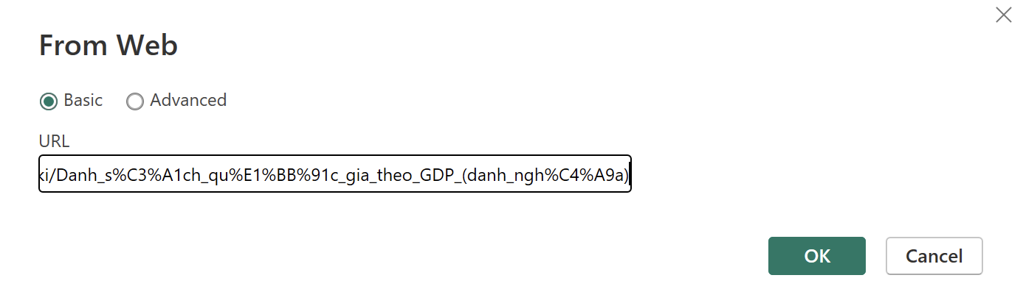
Connect to data (Web)
https://vi.wikipedia.org/wiki/Danh_s%C3%A1ch_qu%E1%BB%91c_gia_theo_GDP_(danh_ngh%C4%A9a)
https://en.wikipedia.org/wiki/UEFA_European_Championship
5

Slide 8
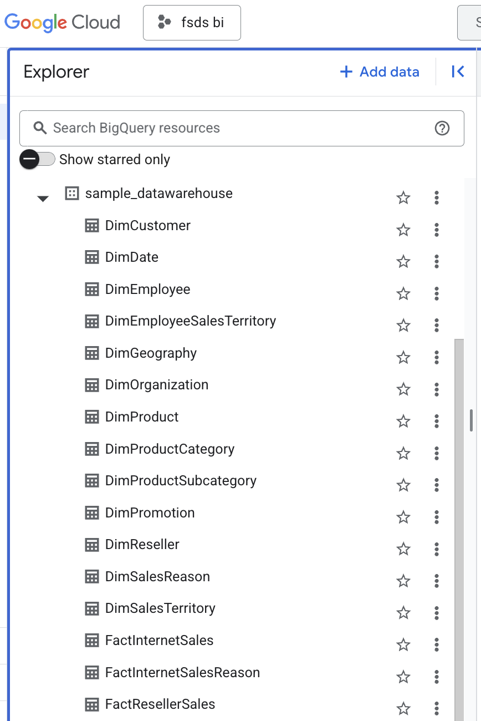
Practice 1
Load the required
data tables into Power BI
(Write SQL => PBI)
5

Slide 9
Prepare data
Get data and Prepare data are the first two steps and also the two steps that determine the accuracy of the analysis.
3

Slide 10
Why do we have to prepare data?
Data is often not ready for analysis, so we have to prepare data
Wrong Data Type
Missing Data
Duplicate Data
5

Slide 11
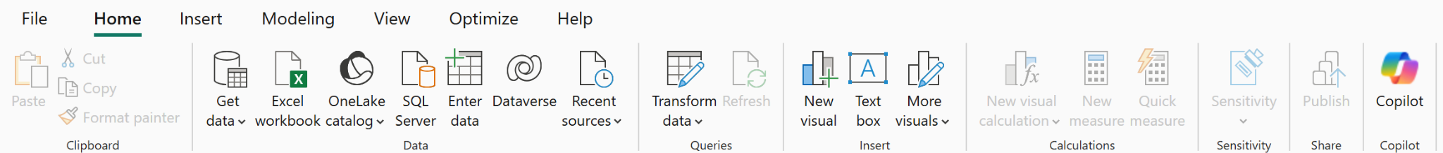
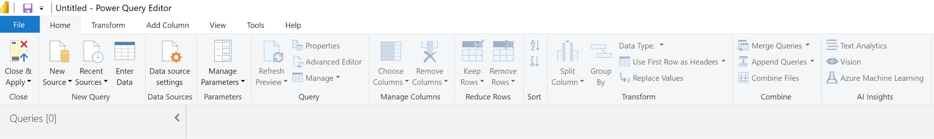
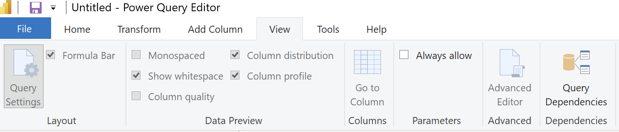
How do we prepare data?
Understand data by Power BI
5

Slide 12

Three main fundamental steps of an effective EDA
Step 1: Data Overview an Descriptive Statistics
Step 2: Data Quality Evaluation
Step 3: Correlation
With Power BI, we can quickly do step 1 and step 2 to understand the data using Data Profiling.
5

Slide 13
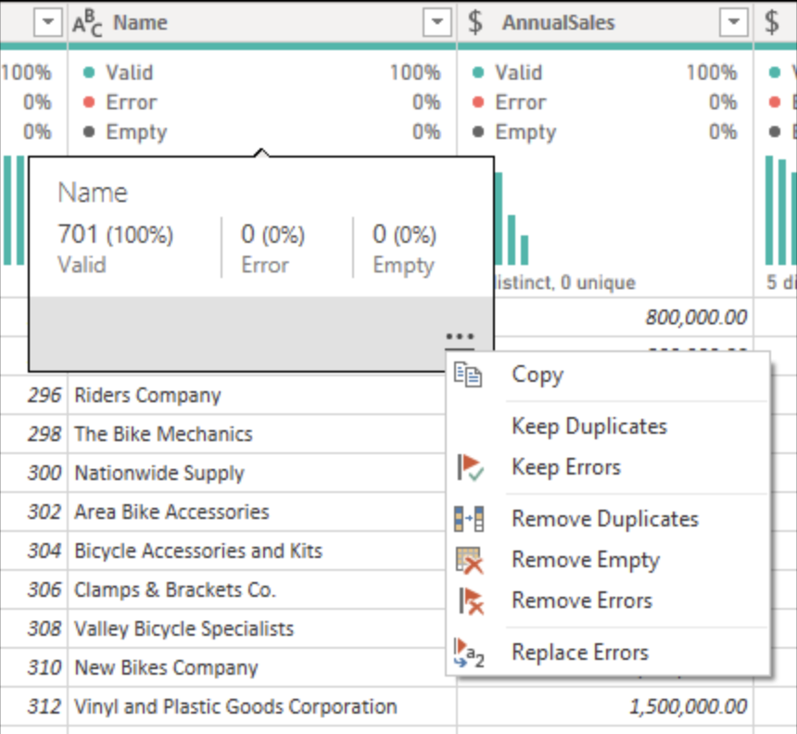
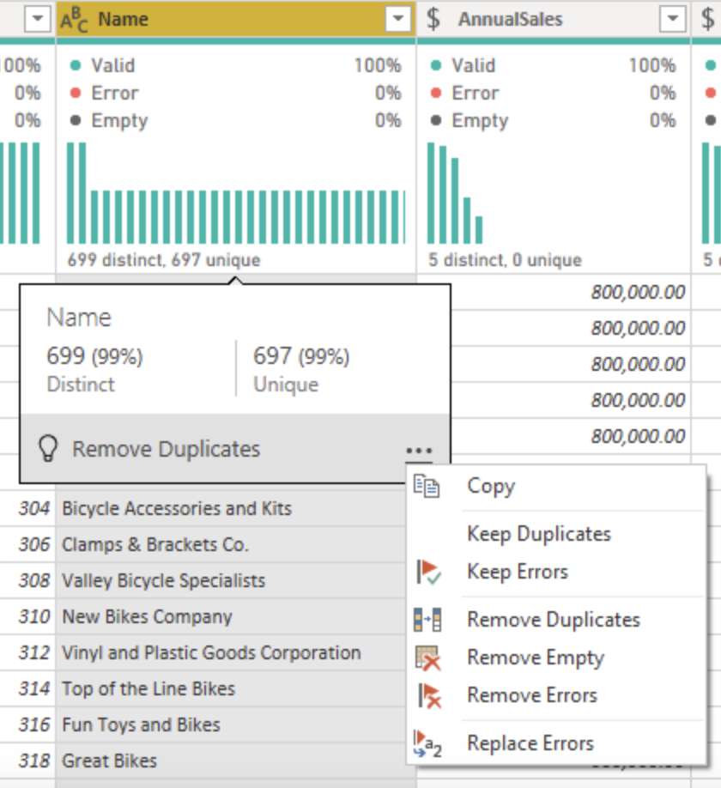
Using the data profiling tools
Column Quality
Column Distribution
5

Slide 14
Practice 2
Rename all tables
Filter only keeps Sales employees (Note based on DimEmployee table and SalesPersonFlag column)
Delete all columns in DimEmployee table and keep only: EmployeeKey, EmployeeNationalIDAlternateKey, FirstName, LastName, Title, EmailAddress
Merge “First Name" và “Last Name" in DimEmployee Table
In the DimReseller table, delete all columns and keep only ResellerKey, BusinessType, ResellerName, DimGeography
Expand the DimGeography column and add only the following columns: City, StateProvinceName, EnglishCountryRegionName
(How to get City_name column in PBI-Bigquery)
In the DimReseller table, replace the "Ware house" values ​​in the "BusinessType" column to "warehouse"
5

Slide 15

fullstackdatascience.com
References
https://dataedo.com/samples/html/Data_warehouse/doc/AdventureWorksDW_4/home.html
11

Slide 16





Thank you
096 574 90 25
CREATED BY
Nguyen Tien Huy
info@robusto.ai
fullstackdatascience
huynt@fullstackdatascience.com
Data Manager
https://fullstackdatascience.com/
Hanoi, Vietnam

